Slide 1
Assignment - NordCloud
Israel saiyid

Slide 2
Setting Up Ghost Application on Azure
There can be multiple ways to do this like-
Forking the Ghost repo, modifying and extending its code to run on Azure App Service. See- Ghost-Azure by Radoslav Gatev, Ghost-Azure by Yannick Reekmans
Using containers- docker-compose and MySQL See- Ghost-By Lorenz Vanthillo
Using AKS See- Ghost- AKS by Curia Damiano
Using Github actions See- GitHub & Ghost
And few other solutions…..
For this demo we will use the AKS approach to meet the requirements

Slide 3
Resources for the Solution
Considering the requirement we would use-
Azure Container Registry offers a secure repository for Docker container images, allowing for precise control over their distribution and seamless integration with Azure Kubernetes Service (AKS).
Azure Kubernetes Service (AKS) streamlines the deployment, management, and scaling of containerized applications using Kubernetes. Its availability zones guarantee robust high availability.
Azure Database for MySQL Server offers fully managed MySQL databases with high availability, simplifying maintenance tasks and ensuring data resilience.
Application Insights - Gain insights into application performance, usage, and errors, enabling proactive optimization and diagnostics.
Log Analytics Workspace offers a central hub for collecting, analyzing, and visualizing logs related to both applications and infrastructure, making troubleshooting and observability more efficient.
Azure Storage Account is the backbone serving the Ghost website's content, ensuring reliable hosting and access to its resources.

Slide 4
Continued….
Azure gateway ingress controller (AGIC)
An Ingress controller is a specialized load balancer for Kubernetes (and other containerized) environments. An Ingress controller abstracts the complexity of Kubernetes application traffic routing and provides a bridge between Kubernetes services and external ones.
Azure Function App for serverless deletion of posts.

Slide 5
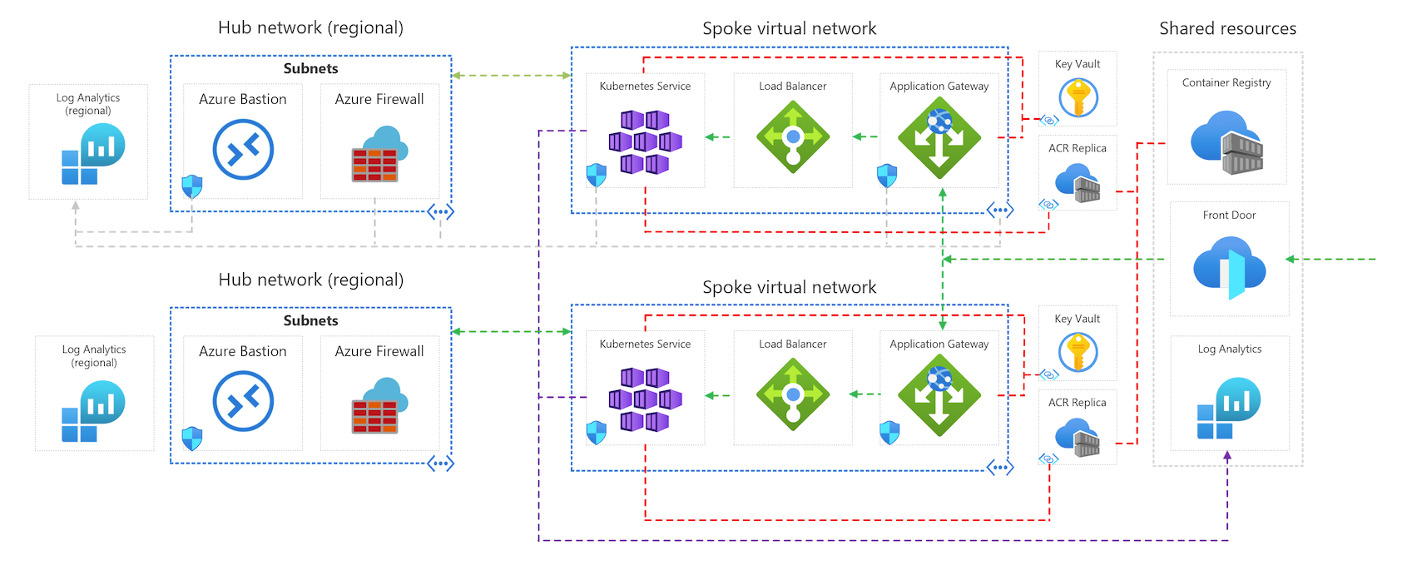
Multi region setup

Slide 6
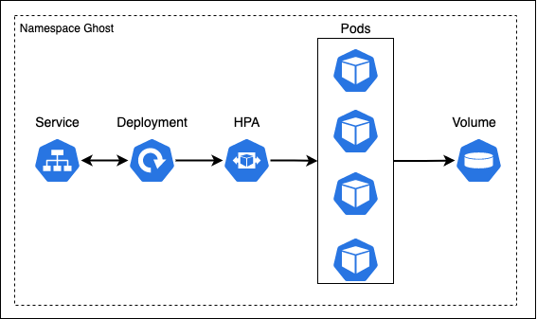
Horizontal Pod Autoscaling

Slide 7
Procedure to deploy
Checkout the GitHub repo
Build the Ghost Docker image using a suitable Dockerfile and push into ACR
Create service connection between Github and Azure DevOps
Install Terraform extension and run the azure-pipelines yml

Slide 8
DEMO

